Slide 1



Cross-lingual Dataless Classification for Many Languages
Yangqiu Song, Shyam Upadhyay, Haoruo Peng, and Dan Roth
Much of the work was done at UIUC

Slide 2
Document Topical Classification
On Feb. 8, Dong Nguyen announced that he would be removing his hit game Flappy Bird from both the iOS and Android app stores, saying that the success of the game is something he never wanted. Some fans of the game took it personally, replying that they would either kill Nguyen or kill themselves if he followed through with his decision.
Pick a label:
Class1 or Class2 ?
Mobile Game or Sports?
Labels carry a lot of information!
But traditional approaches are not using it
Models are trained with “numbers or IDs” as labels
Notes:
Document classification is a classic problem for text mining and nlp applications. The task is to predict the label of a document.
Traditional classification often treats the labels as numbers or IDs to train a classifier for such task.
However as a human, if I want you to choose a label of the document like this, can you tell me which label it is?
No, right? But if I give you the label names, you can easily tell me the decision without any problem.
So the labels really carry a lot of information about the category meaning. If we know the label names, we can even classify the document without any labeled data.
But even with label names, the traditional classification models still treat the labels as numbers or ids and do not consider this information.

Slide 3


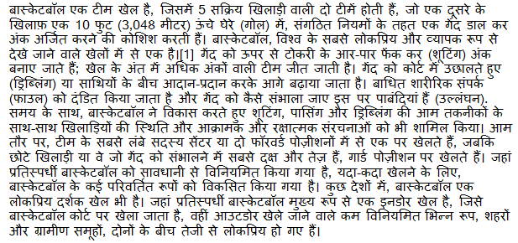
Cross-lingual Document Categorization
How to map a document in language L to an English ontology of semantic categories, without training with task-specific labeled data.
Potentially, given a single document (not a coherent collection)
Economy
-Taxation
Sports
-Basketball

Slide 4
Categorization without Labeled Data [AAAI’08, AAAI’14, NAACL’15]
This is not an unsupervised learning scenario. Unsupervised learning assumes a coherent collection of data points, and that similar labels are assigned to similar data points. It cannot work on a single document.
Given:
A single document (or: a collection of documents)
A taxonomy of categories into which we want to classify the documents
Dataless procedure:
Let f(l_{i}) be the semantic representation of the labels
Let f(d) be the semantic representation of a document
Select the most appropriate category:
l_{i}* = argmin_{i} || f(l_{i}) - f(d)||
Bootstrap
Label the most confident documents; use this to train a model.
Key Questions:
How to generate a good Semantic Representations?
How to do it in many languages, with minimal resources?

Slide 5
General Framework
Mobile Game or Sports?
Label
names
Map labels/documents to the same space
Compute document and label similarities
Documents
World knowledge
(Cross-lingual)
Choose labels
M. Chang, L. Ratinov, D. Roth, V. Srikumar: Importance of Semantic Representation: Dataless Classification. AAAI‘08.
Y. Song, D. Roth: On dataless hierarchical text classification. AAAI’14.
Y. Song, D. Roth: Unsupervised Sparse Vector Densification for Short Text Similarity. HLT-NAACL’15.
Y. Song, S. Upadhyay, H. Peng, D. Roth: Cross-lingual Dataless Classification for Many Languages. IJCAI’16.

Slide 6
Text Representation
[Dense] Distributed Representations (Embeddings)
New powerful implementations of good old ideas
Learn a representation for a word as a function of words in its context
Brown Clusters
An HMM based approach
Found a lot of applications in other NLP tasks
[Sparse] Explicit Semantic Analysis (ESA)
A Wikipedia driven approach – best for topical classification
Represent a word as a (weighted) list of all Wikipedia titles it occurs in
Gabrilovich & Markovitch 2009
Cross-lingual ESA:
Exploits the shared semantic space between two languages
The ideal representation is task specific.
These ideas can be shows also in the context of more involved tasks such as Events and Relation Extraction
No task specific supervision. Wikipedia is there.

Slide 7
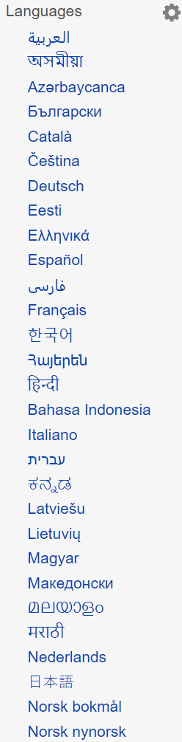
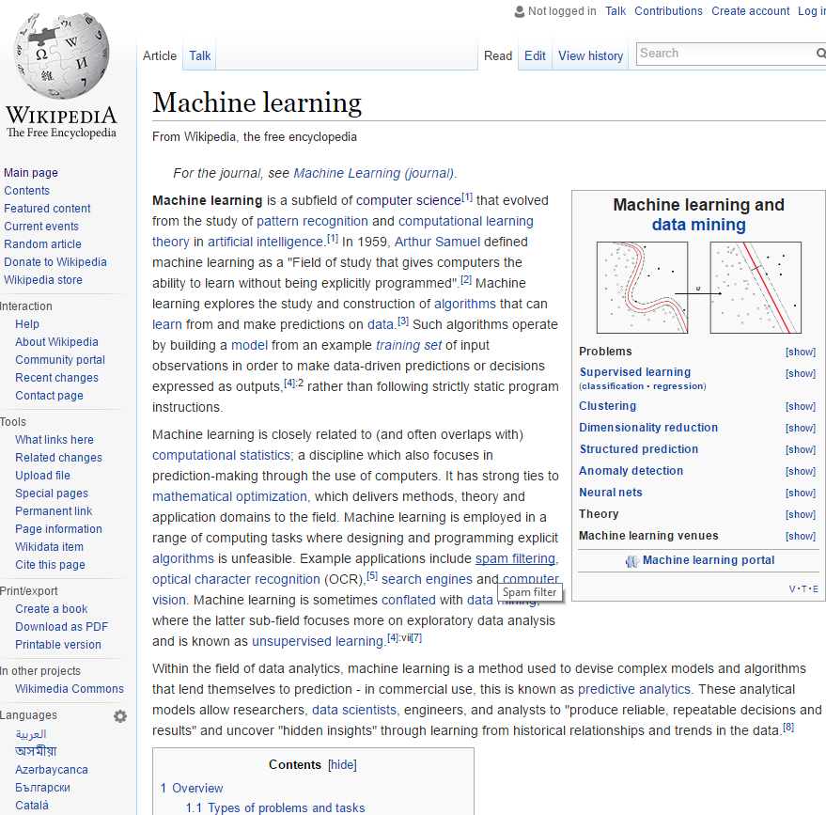
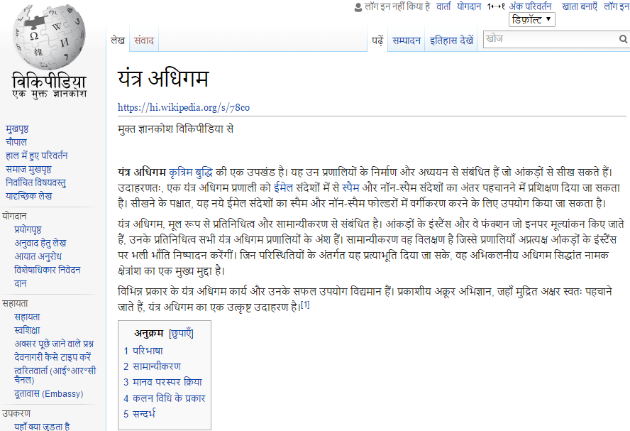
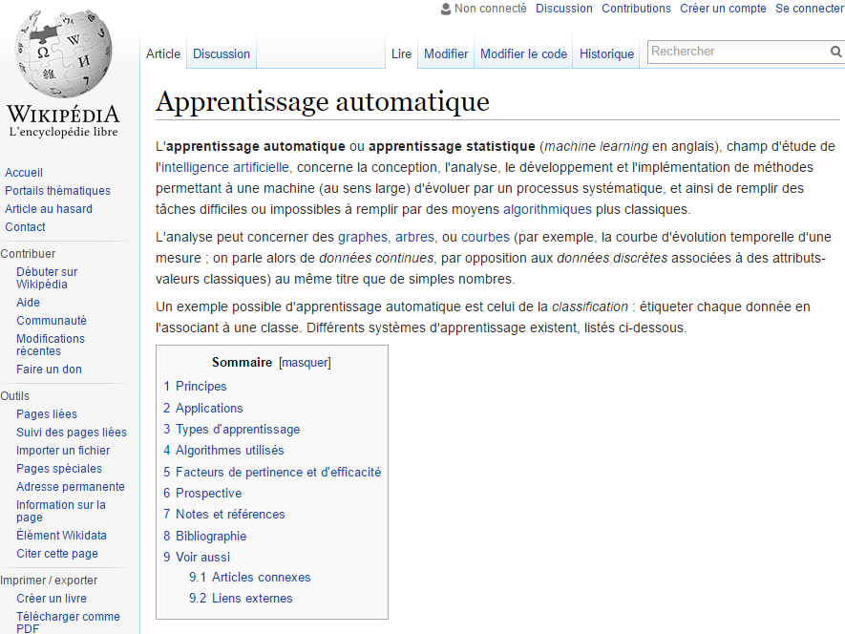
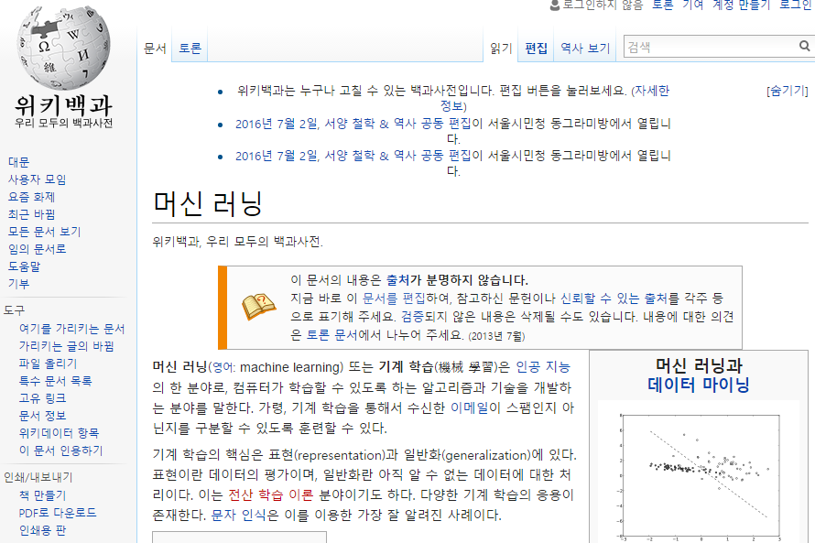
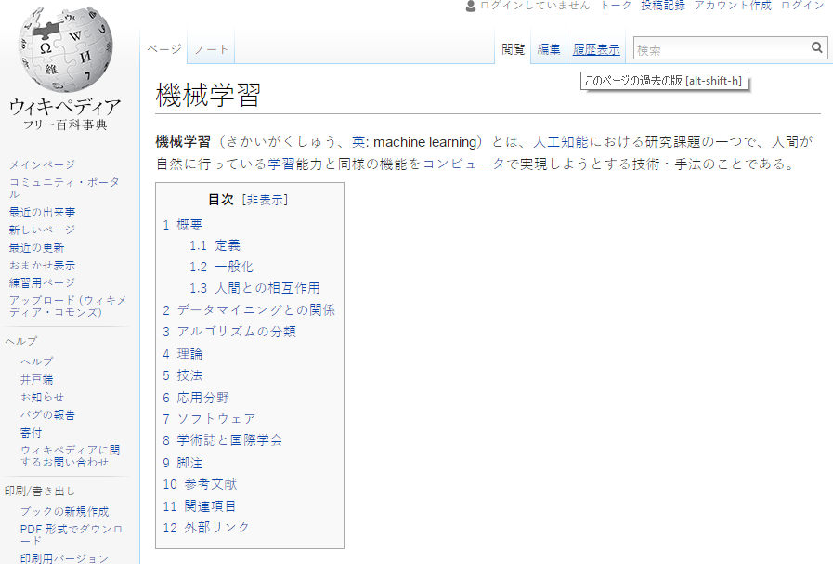
Language Links

Slide 8
Wikipedia Pages Across Languages
Topical classification of documents in language L relies on:
The availability of L-Wikipedia
The existence of a title space mapping between L and English
292 languages have Wikipedia.
We filter the title space to only include long, well linked pages that are linked to the English Wikipedia, yielding 179 languages.
 | English | Deutsch | Spanish | Hindi
# Wikipedia Pages | >15.8M | 3,653,951 | 3,165,178 | 179,131
# Pruned pages: (Len>=100, link>=5) | 3,090,649 | 1,482,675 | 914,927 | 33,298
# Pages linked to English Wikipedia |  | 459,421 | 342,285 | 16,463

Slide 9
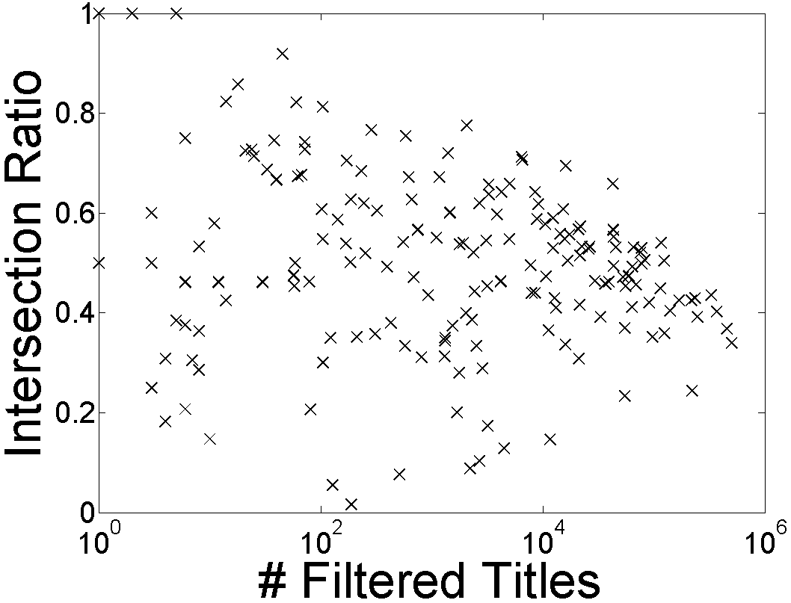
Percentage of Language Links to English
179 Wikipedia we can collect from Wikipedia dump
Notes:
The languages above the line may be good to us

Slide 10
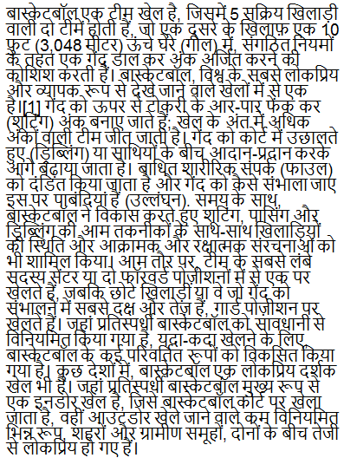
Cross-lingual Semantic Similarity – For One Document
Cross-lingual Explicit Semantic Analysis (CLESA)
Build inverted index of English and L-Wikipedia
Search using English label and L-language document as queries
Compute similarity based on the intersected Wikipedia titles
Hindi Document
Wikipedia Articles
English Wikipedia
Hindi Wikipedia
English Label
Search
Search
Label:
Sports
Cosine Similarity
cos[e(l_{i}), c(h(d))]
Martin Potthast, Benno Stein, and Maik Anderka. A wikipedia-based multilingual retrieval model. In ECIR, pages 522–530, 2008.
Philipp Sorg and Philipp Cimiano. Exploiting wikipedia for cross-lingual and multilingual information retrieval. Data and Knowledge Engineering, 74:26–45, 2012.
Notes:
To be more formal. A five step algorithm.

Slide 11
Bootstrapping with Unlabeled Data
Initialize N documents for each label
Pure similarity based classifications
Train a classifier to label N more documents
Continue to label more data until no unlabeled document exists
Application of world knowledge of label meaning
Domain adaptation
Mobile games
Sports

Slide 12
Experiments
Two existing multilingual text categorization collections:
TED: 13 languages; 15 labels; 1200 docs/label.
RCV2: 13 languages; 4 labels (top level); 10²—10⁴ docs/label.

Slide 13
TED DATA
Better than 100 supervised docs/label
Not as good as 500 docs/label
RCV DATA
Karl Moritz Hermann and Phil Blunsom. Multilingual models for compositional distributed semantics. In ACL, pages 58–68, 2014.
Notes:
Change dataless to Cross-lingual ESA

Slide 14
Experiments
Two existing multilingual text categorization collections:
TED: 13 languages; 15 labels; 1200 docs/label.
RCV2: 13 languages; 4 labels (top level); 10²—10⁴ docs/label.
To evaluate the coverage, we generate a new data set.
20 newsgroups.
Take 100 documents that the English dataless classifies correctly
Translate to 88 languages using Google Translate
This gives us a multi-lingual collection for which we know the labels
Evaluate the Cross-lingual dataless

Slide 15
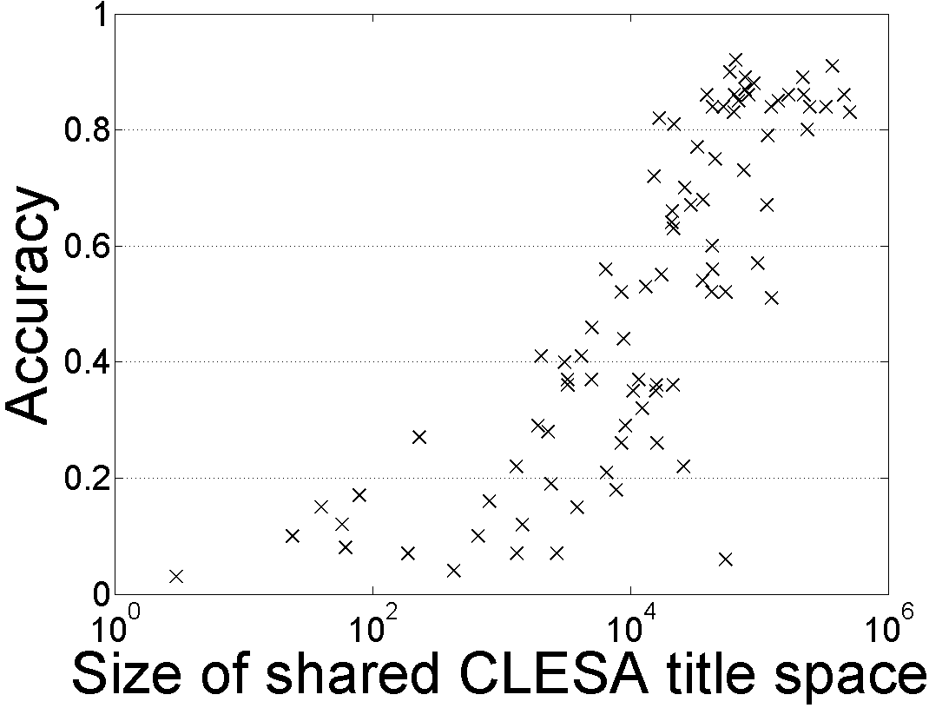
88 Languages: Single Document Classification
Dataless classification for English
Accuracy
Hausa
Hindi
Size of shared English-Language L title space

Slide 16
Conclusions
Document categorization without labeled data
Semantic representation plays the key role
Cross-lingual dataless classification
Applied to many languages
Cross-lingual ESA outperformed standard word embeddings
Comparable supervised learning with 100-200 per-label
Future work
Low-resource languages
Small presence of Wikipedia
Thank You! ☺

Slide 18
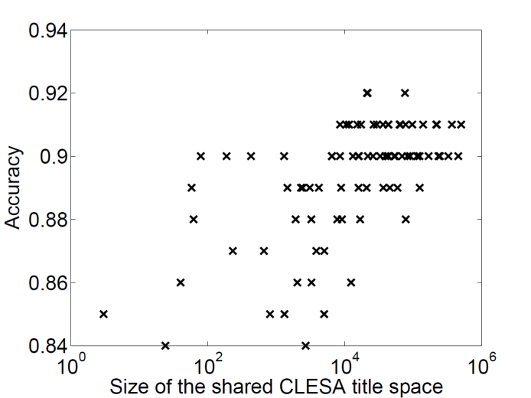
Translate 100 documents of 20-newsgroups back to English
English ESA based dataless classification
E. Gabrilovich and S. Markovitch. Wikipedia-based Semantic Interpretation for Natural Language Processing. J. of Art. Intell. Res. (JAIR). 2009.
M. Chang, L. Ratinov, D. Roth, V. Srikumar: Importance of Semantic Representation: Dataless Classification. AAAI‘08.
Y. Song, D. Roth: On dataless hierarchical text classification. AAAI’14.

Slide 19
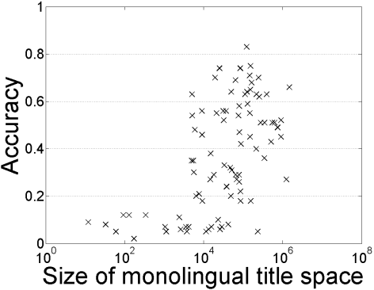

Cross-lingual Classification for 88 languages
Single document classification without bootstrapping
Hindi: 0.33/0.82
Hausa: 0.12/0.08

